Slide 1
Amazon’s Marketing
Name

Slide 2
Introduction
Amazon Inc. is a tech giant company that is based in Seattle, Washington in United States.
I feel attracted to the way the company operates – with effectiveness all around and making huge profits day after the other.
It has integrated technology advancements to its merit - bringing customers under social media platforms.
The internet has been an avenue, not for Amazon alone, but for many other brands over the globe

Slide 3
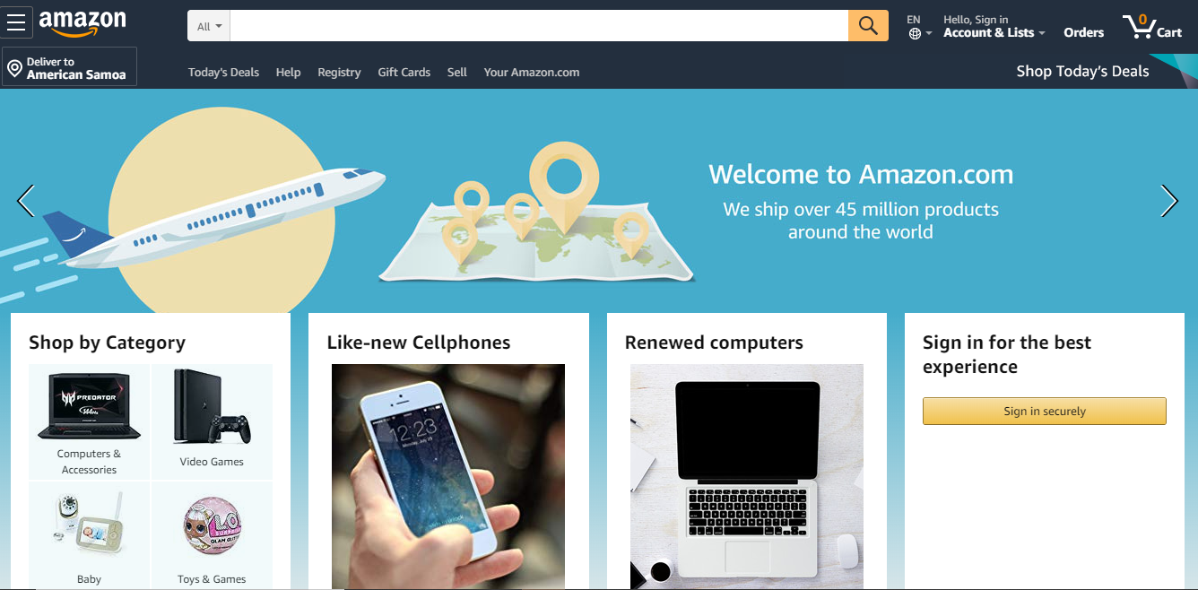
Amazon.com Website
Amazon’s website is one of the most visited websites in the entire globe.
The website is very developed with different categories of products that is meant to help consumers within just a click. E.g. Whole foods, books, Health & Households, Music. See picture;

Slide 4
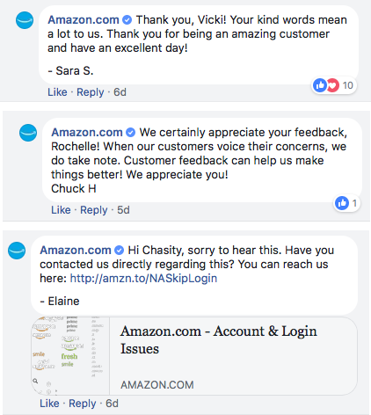
Amazon.com Facebook integration
The page has a “shop now” button which redirects the users to the Amazon website for purchases and delivery to their locations
It adds a human touch by addressing users by their first name
Offers room for customer reviews

Slide 5
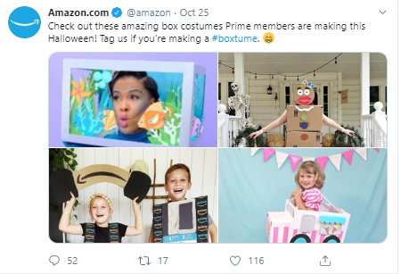
Amazon.com Twitter
The company’s twitter was mostly used for campaigns but today it is used less on promotions.
It offers additional services like Amazon Music and Prime Video (Erkan & Evans, 2018).
Importantly, it is used to promote the blog content of the company (mostly small business advice and delivering news about various things).

Slide 6
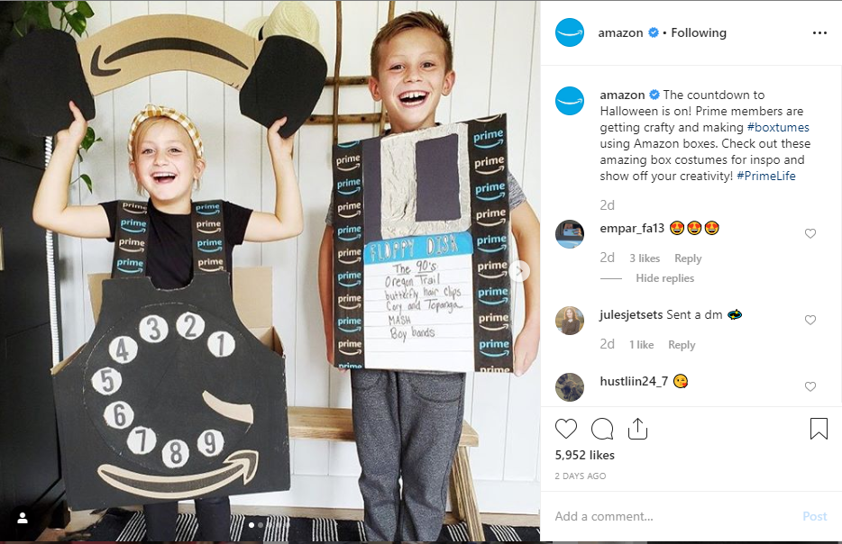
Instagram
Instagram is another social app that has been so useful to individual businesses, corporations, and organizations in terms of marketing.
The company’s Instagram page has the brand logo and the amazon.com website link.

Slide 7
Conclusion
The advantages of these social media integrations:
  sale volumes increase
  reaches many
  responses to clients in a quick manner and providing useful information and links is enabled

Slide 8
THANK YOU ALL!

